Slide 1
Online Bus Ticket Booking System
By Shaurya Verma(03411404419)
Shristi Jain(01511404419)

Slide 2
Online Bus ticket Booking
This Online Bus Ticket Booking System project will provide an Online Bus Ticket Booking platform and thereby leverage the tedious manual ticket booking activity for a customer. We can provide a feature that will allow the customer to get a ticket booked without much hassle.
Initially, customers used to book tickets manually by queuing in lines at bus stations or go to travel agents who in turn used to book tickets for them. This was actually a tedious process and was leading to wastage of time. It also had issues like having incorrect names or other information used to book tickets.

Slide 3
Problem Statement
With an increasing number of customers, standing in long queues at the bus stop. The bus ticket managers were facing the challenge of providing their customers a “hassle free ticket booking”.
Customers desperately wanted an easy way of booking their tickets without the delays and inconvenience of standing in long queues. The management needed a mechanism to administer their loyalty program” of hassle-free booking which saves time of user in booking tickets

Slide 4
Solution
The online bus ticket booking platform which would enable passengers to book their tickets electronically over the Internet from the comfort of their office or home. With the advent of the modern age, the typical user didn't have enough time to stand in line at bus stop. The online solution allows users to select their bus, book and print their tickets. This guarantees them a ticket even before they arrive at the bus stop.

Slide 5
Modules
Admin Module
Admin can Login add bus, manage bookings, manage users, view passengers
User Module
User can book tickets, view bus timings, delete bookings, reset passwords, download tickets.

Slide 6
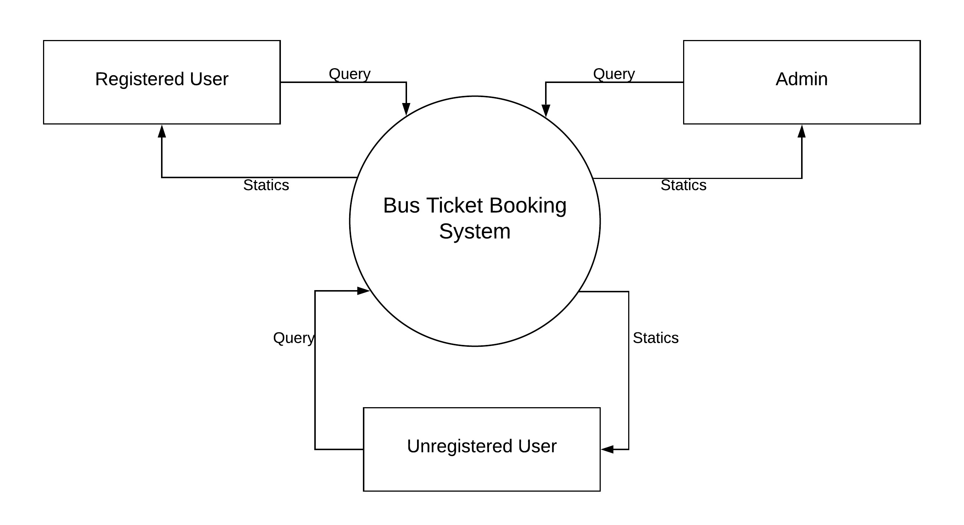
Data Flow Diagram
Level 0 DFD

Slide 7
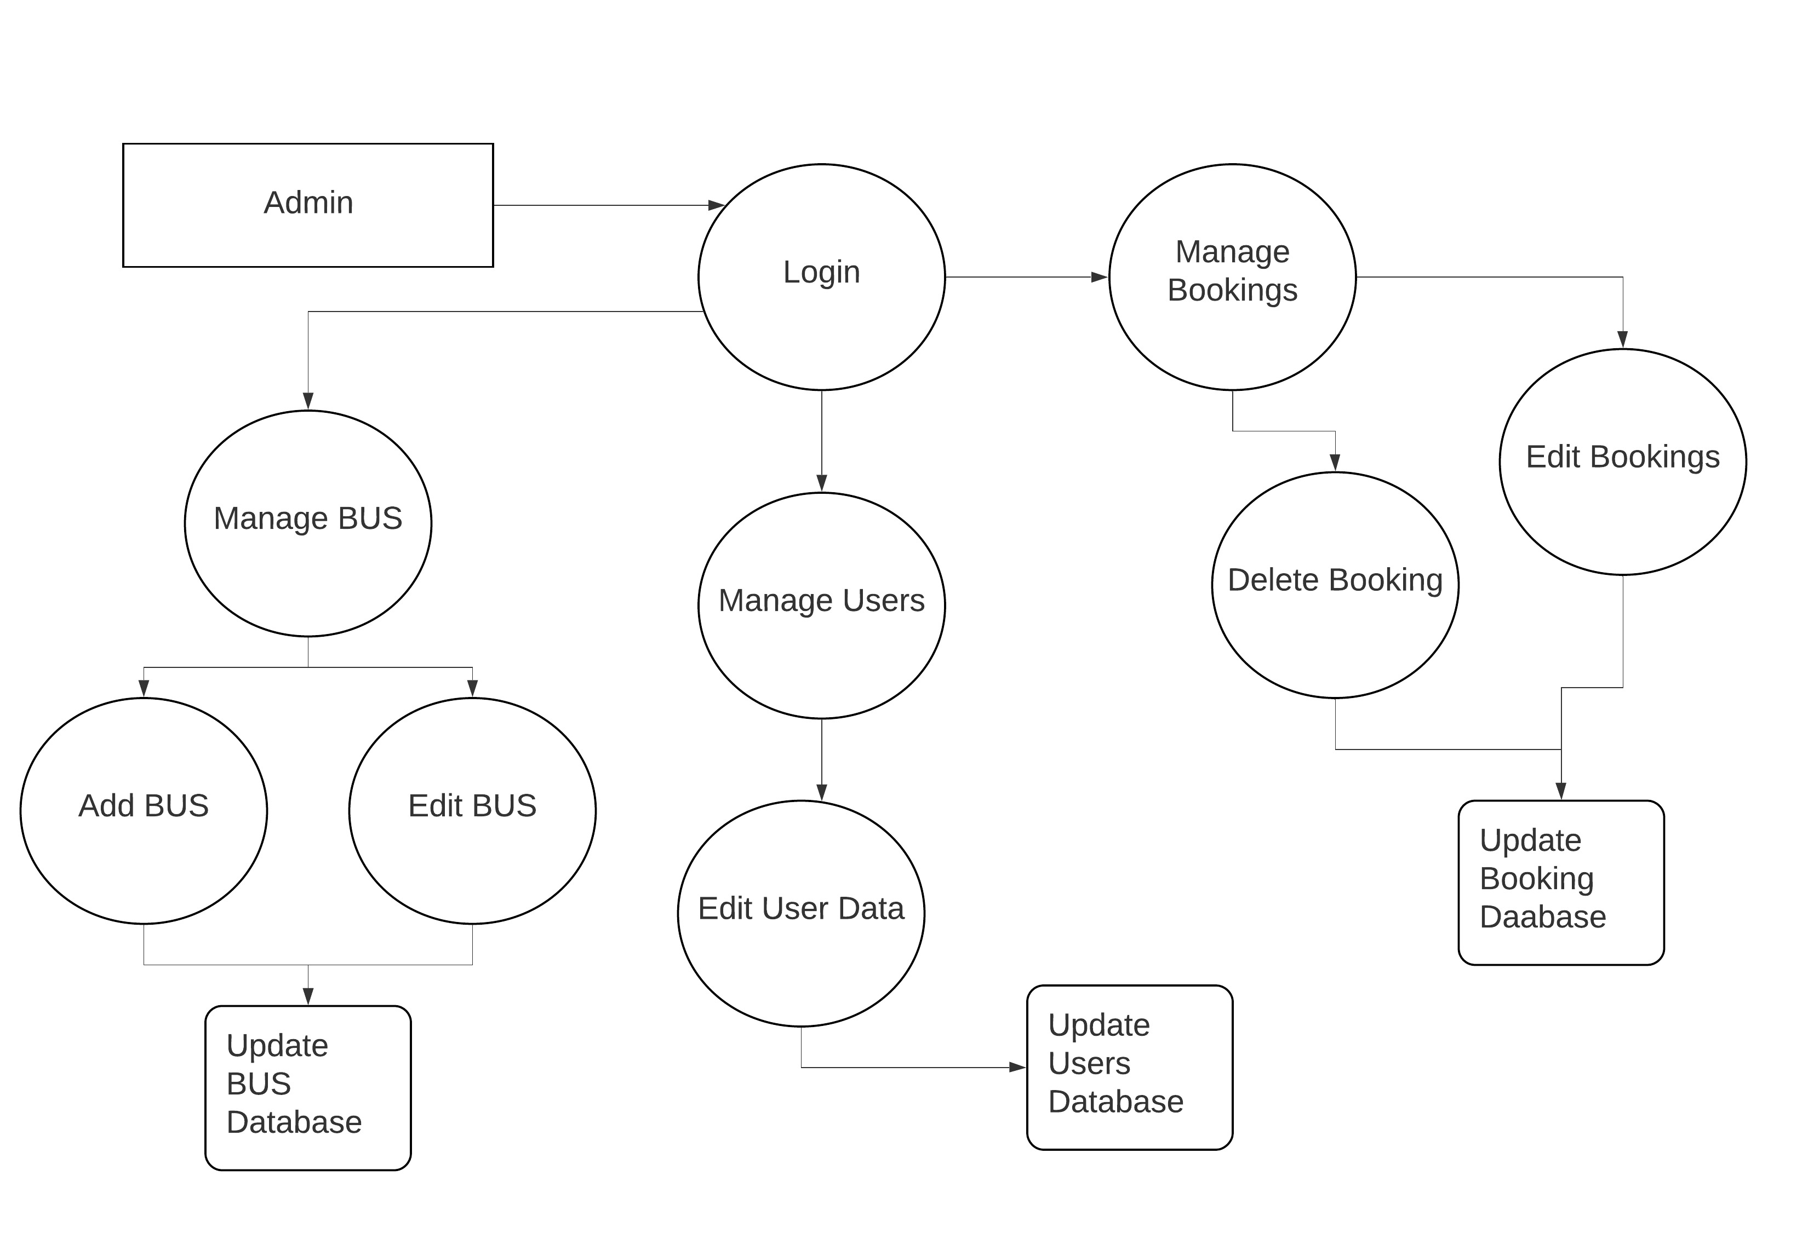
Admin DFD

Slide 8
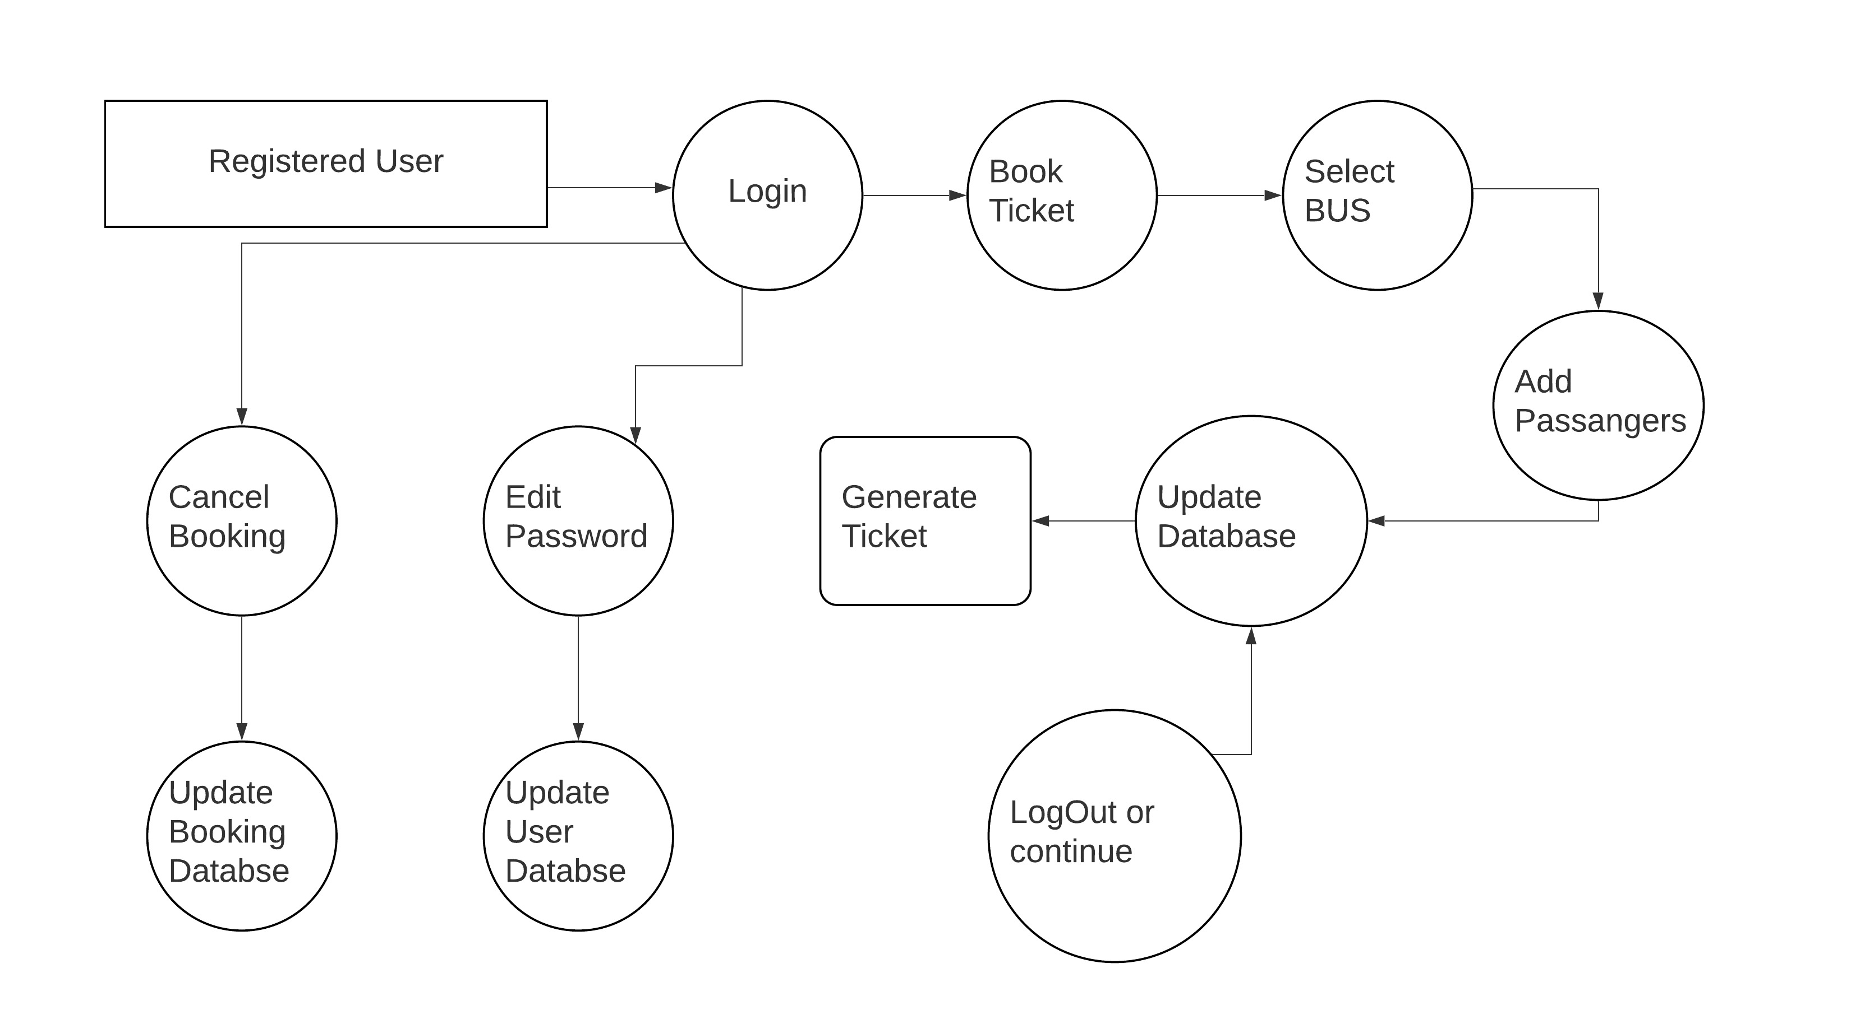
DFD For Registered User

Slide 9
Thank You

